Slide 1
Resume Classification using NLP

Slide 2
Group Members-
Ms. Komal Nikole
Ms. Misba Pathan
Mr. Nitish Rajendra Kale
Mr. Kshitij Adesh Jadhav
Mr. Naman Lodhi
Ms. Basireddy Thanusha Reddy
Mr. Ranajitsinh Tukaram Jadhav

Slide 3
Introduction-
The amount of resume that companies get is insane. It takes a lot of time to check every single resume manually.
In order to reduce this effort, Resume classification can be done using Machine Learning.
The document classification solution should significantly reduce the manual human effort in the HRM. It should achieve a higher level of accuracy and automation with minimal human intervention Sample Dat Set.

Slide 4
Data set-
The data set contains 79 resumes divided into 4 categories. They are –
Peoplesoft resumes
React resumes
SQL Developer Lightning insights resumes
Workday resumes
The resume are in 3 different formats-
.doc
.docx
.pdf

Slide 5
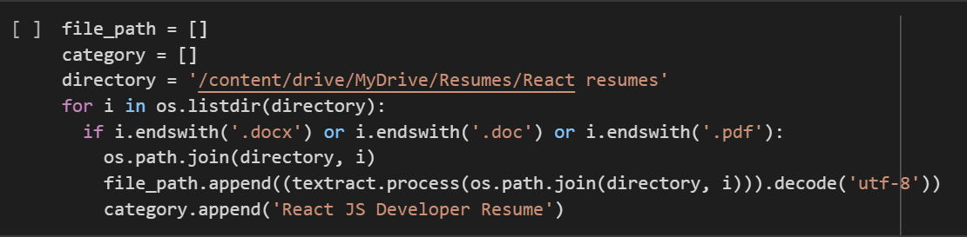
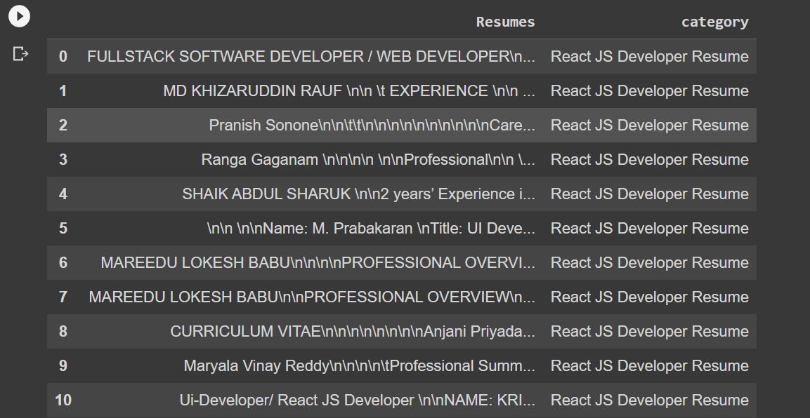
Extraction-

Slide 6
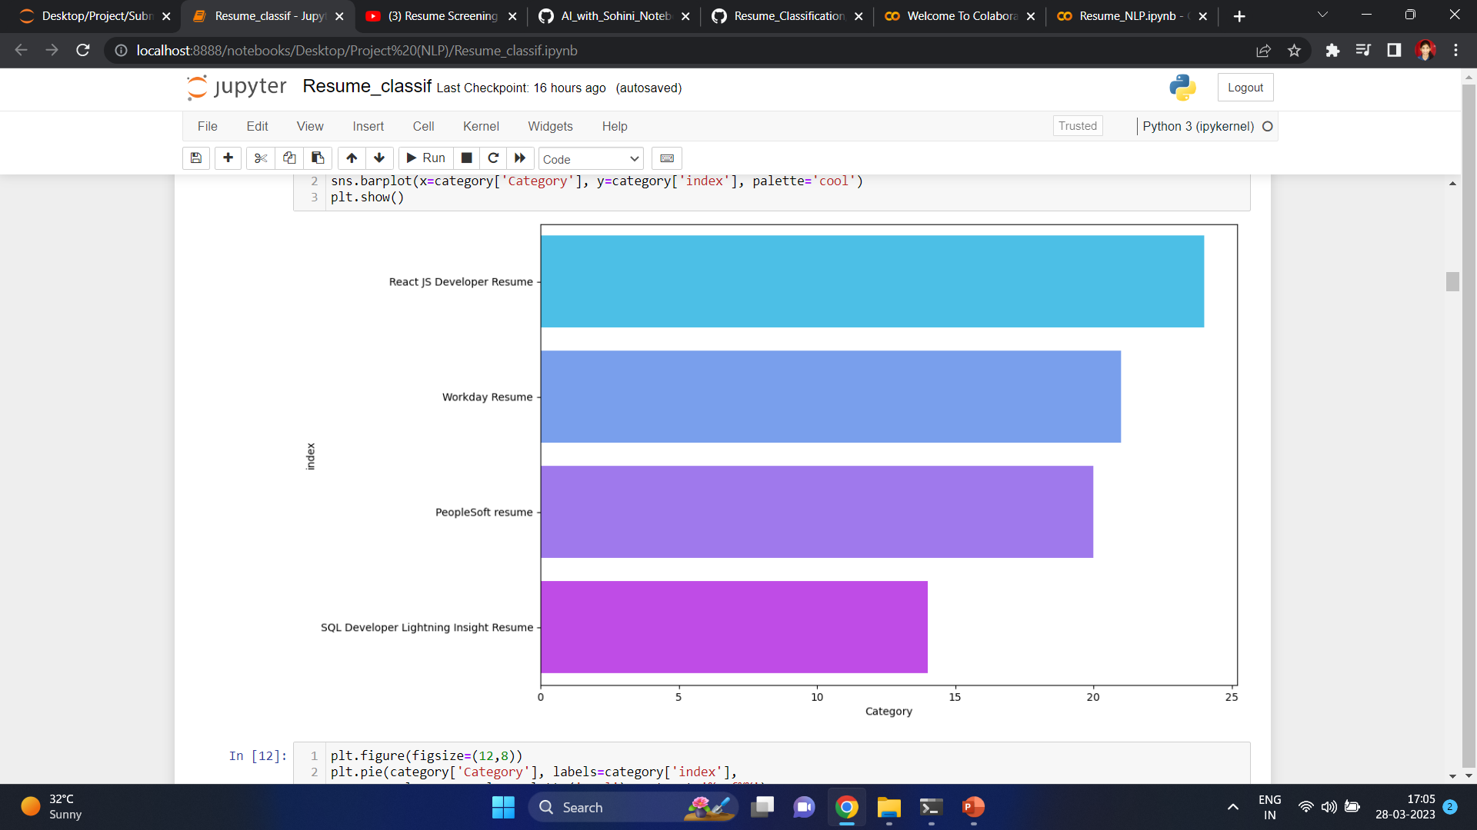
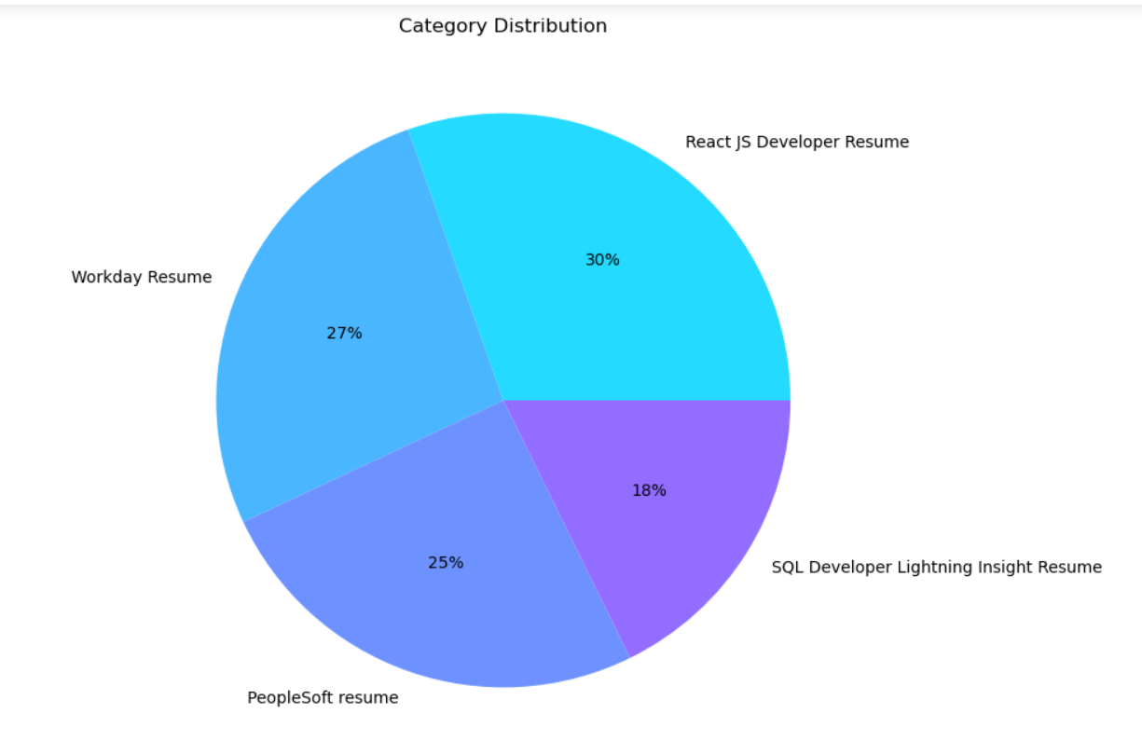
EDA and Data Preprocessing

Slide 7
Text Processing-
Remove patterns.
Remove Urls
Text cleaning – Punctuations, lowercase, Square brackets, etc
Removing Emogis
Applying Tokenization
Removing stopwords
Applying Lemmatization
Applying CountVectorizer
Applying CountVectorizer on NGrams

Slide 8
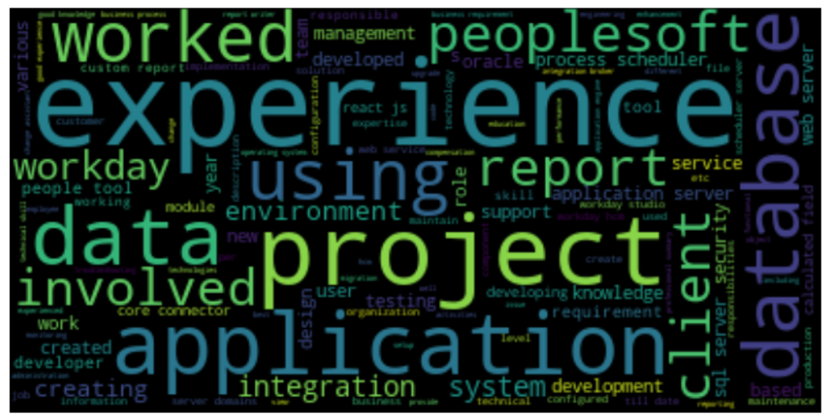
Most used words-

Slide 9
Wordcloud-

Slide 10
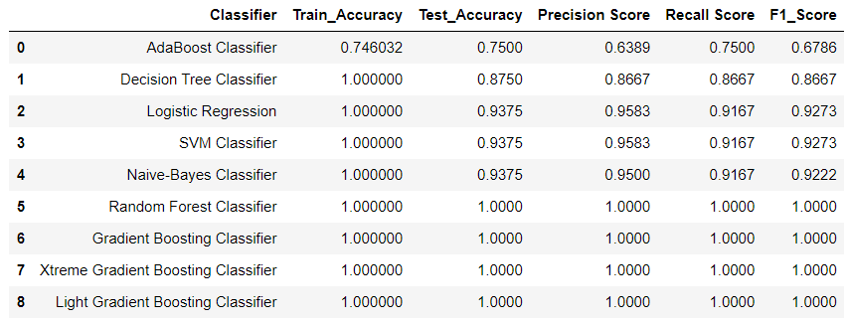
Model building-

Slide 11
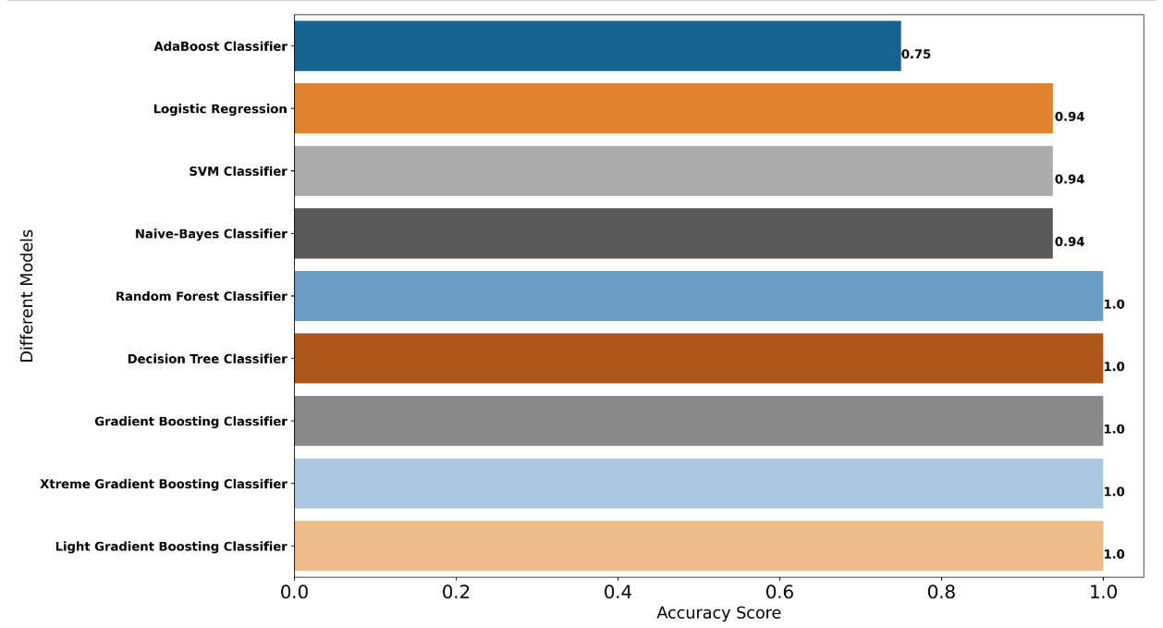
Model Evaluation -

Slide 12
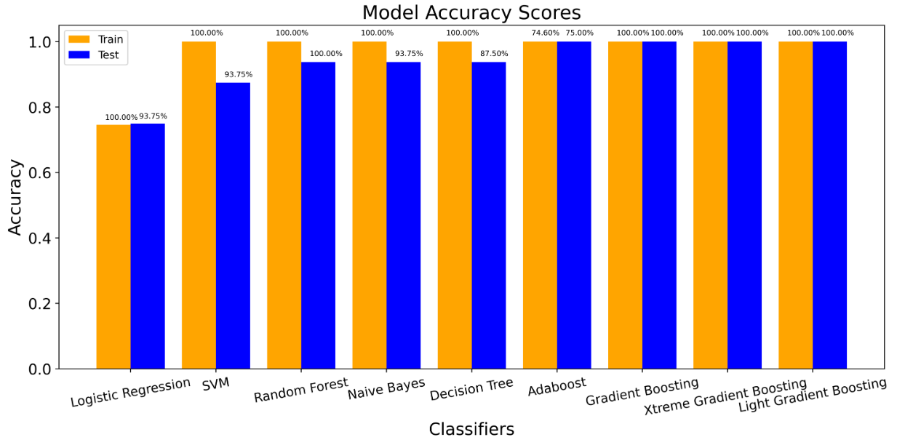
Train and Test Accuracy -

Slide 13
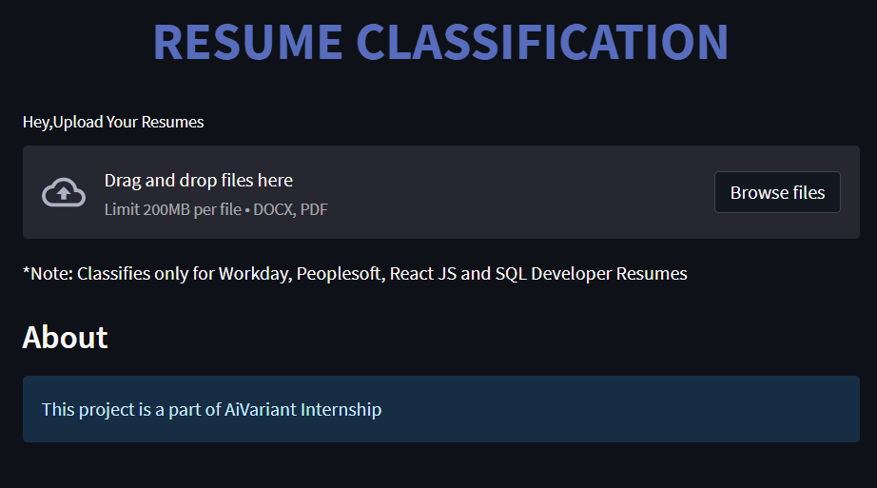
Model Deployment -

Slide 14
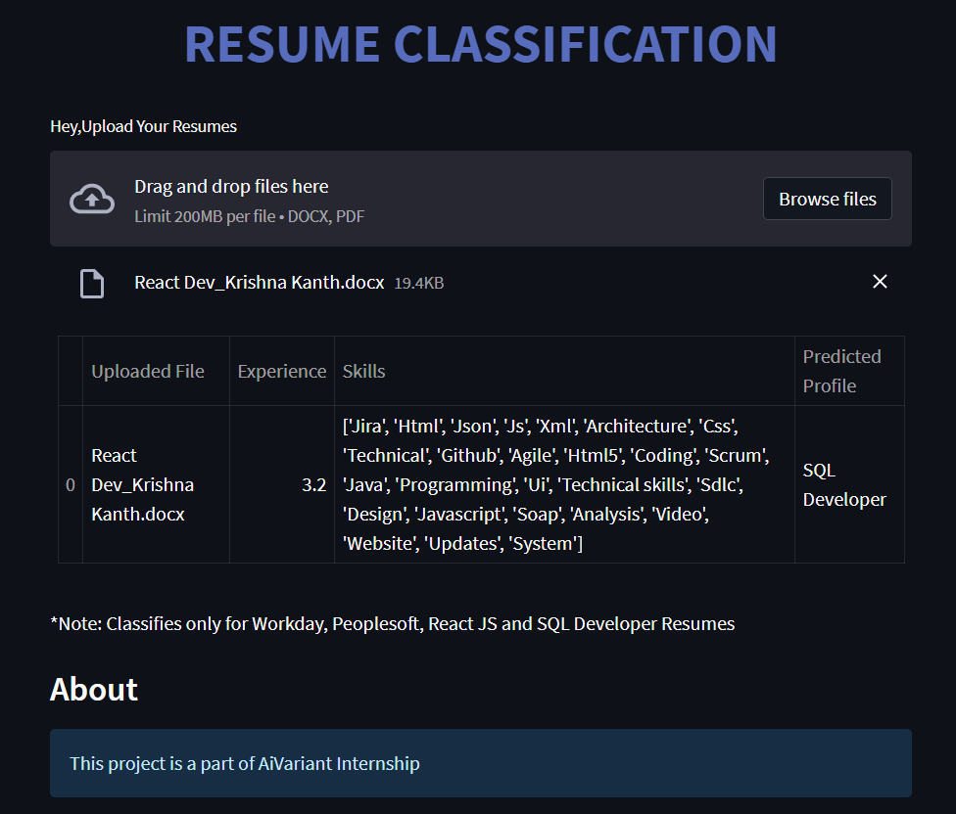

Slide 15
Thankyou

